Slide 1
Unit 1:
Collections

Slide 2

Collection types
Array
Dictionary
Set
Tuple

Slide 3
Arrays
Defining
[value1, value2, value3]
var names: [String] = ["Anne", "Gary", "Keith"]
Notes:
Note
Shows the syntax: [value1, value2, value3, …].
Say
True or false: Swift should be able to infer the "[String]" part.
Answer: True (as shown on the next slide).

Slide 4
Arrays
Defining
[value1, value2, value3]
var names = ["Anne", "Gary", "Keith"]
Notes:
Say
The compiler can do type inference for collections, too.
Note
Shows var names as type inferred to [String].

Slide 5
Arrays
Defining
var numbers = [1, -3, 50, 72, -95, 115]
Notes:
Say
The var numbers = [1, -3, 50] would be [Int].
What if you want to restrict the array to Int8? Just specify it.

Slide 6
Arrays
Defining
var numbers: [Int8] = [1, -3, 50, 72, -95, 115]

Slide 7
contains
let numbers = [4, 5, 6]
if numbers.contains(5) {
print("There is a 5")
}
There is a 5
Notes:
Say
someArray.contains(someInstance) returns true if true.
Note
Contains uses == (the Equatable protocol).

Slide 8
Array types
var myArray: [Int] = []
var myArray: Array<Int> = []
var myArray = [Int]()
Notes:
Note
Shows the many ways to declare the type of things in an array.

Slide 9
Working with arrays
repeating
var myArray = [Int](repeating: 0, count: 100)
let count = myArray.count
if myArray.isEmpty { }
Notes:
Note
Shows the repeating Array initializer:
var myArray = [Int](repeating: 0, count: 100)
Creates an array filled with 100 zeros.
Shows someArray.count (returns Int).
Shows someArray.isEmpty (returns Bool).

Slide 10
Working with arrays
Accessing or setting a specific item
var names = ["Anne", "Gary", "Keith"]
let firstName = names[0]
print(firstName)
Anne
names[1] = "Paul"
print(names)
["Anne", "Paul", "Keith"]
Notes:
Say
Change or retrieve a value by using array subscripting syntax which is similar to other languages.

Slide 11
Working with arrays
Appending
var names = ["Amy"]
names.append("Joe")
names += ["Keith", "Jane"]
print(names)
["Amy", "Joe", "Keith", "Jane"]
Notes:
Note
Shows someArray.append("object").
append() is limited to 1 item.
append from array is: someArray.append(contentsOf: someOtherArray)
Shows someArray += ["Keith", "Jane"].

Slide 12
Working with arrays
Inserting
var names = ["Amy", "Brad", "Chelsea", "Dan"]
names.insert("Bob", at: 0)
print(names)
["Bob", "Amy", "Brad", "Chelsea", "Dan"]
Notes:
Note
Shows someArray.insert("object" at: 0).
Say
Note that there's also someArray.insert(contentsOf: someOtherArray at: ).

Slide 13
Working with arrays
Removing
var names = ["Amy", "Brad", "Chelsea", "Dan"]
let chelsea = names.remove(at:2)
let dan = names.removeLast()
print(names)
["Amy", "Brad"]
names.removeAll()
print(names)
[]
Notes:
Say
Note that remove(at:) returns the removed item.
Note
There's also removeFirst() and removeSubrange().

Slide 14
Working with arrays
var myNewArray = firstArray + secondArray“
let containerArray = [array1, array2] // [ [1,2,3], [4,5,6] ]
let firstArray = containerArray[0] // [1,2,3]
let firstElement = containerArray[0][0] // 1

Slide 15
Working with arrays
Arrays within arrays
let array1 = [1,2,3]
let array2 = [4,5,6]
let containerArray = [array1, array2]
let firstArray = containerArray[0]
let firstElement = containerArray[0][0]
print(containerArray)
print(firstArray)
print(firstElement)
[[1, 2, 3], [4, 5, 6]]
[1, 2, 3]
1

Slide 16
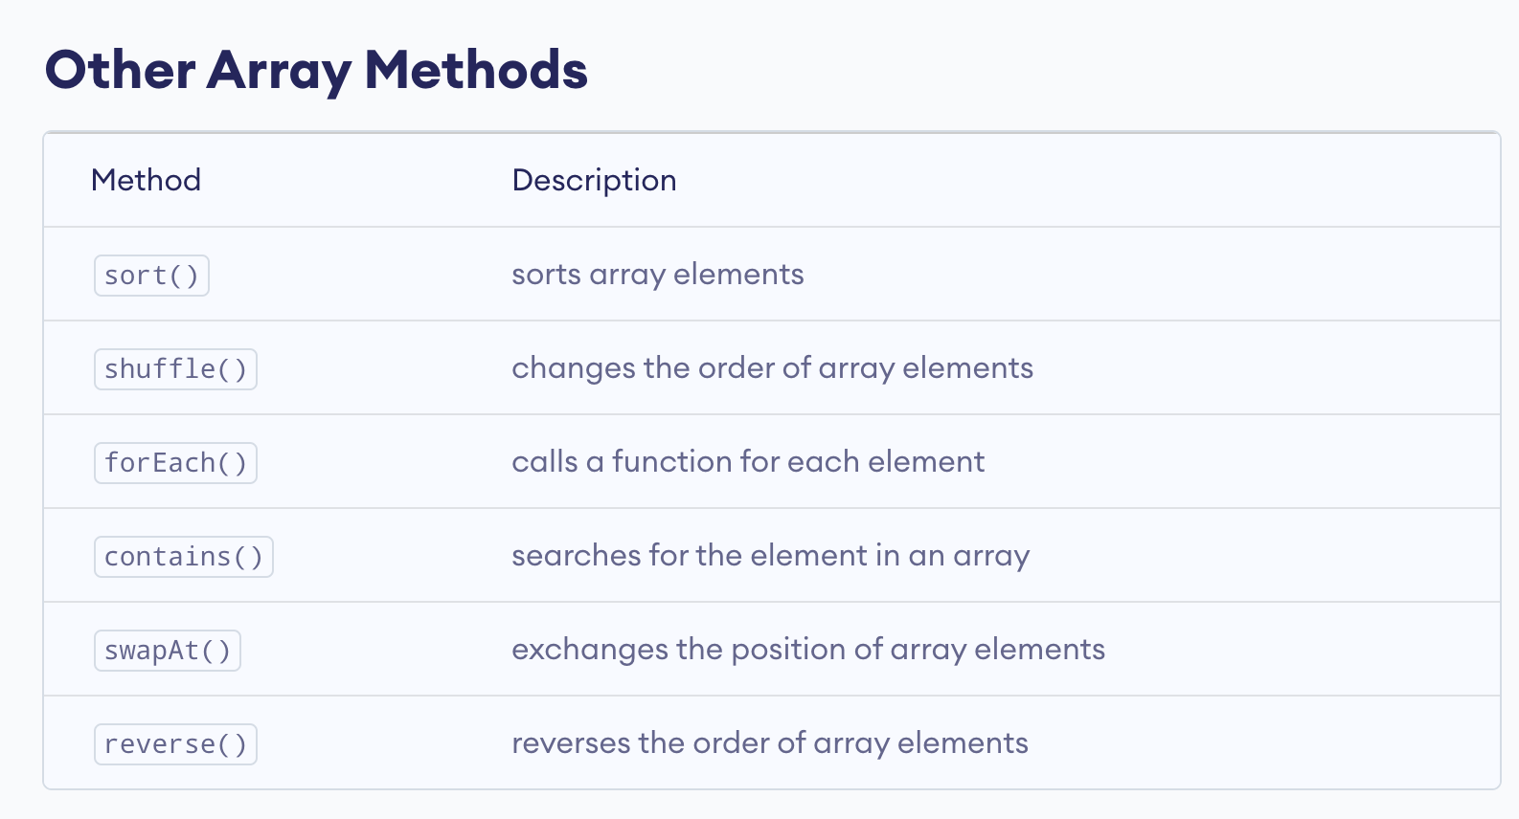
Other Array Methods

Slide 17
Dictionaries
[key1 : value1, key2: value2, key3: value3]
var scores = ["Richard": 500, "Luke": 400, "Cheryl": 800]
var myDictionary = [String: Int]()
var myDictionary = Dictionary<String, Int>()
var myDictionary: [String: Int] = [:]
Notes:
Note
Shows literal syntax and ways to instantiate.

Slide 18
Add/remove/modify a dictionary
Adding or modifying
var scores = ["Richard": 500, "Luke": 400, "Cheryl": 800]
scores["Oli"] = 399
let oldValue = scores.updateValue(100, forKey: "Richard")
Notes:
Say
scores["Oli"] = 399 will update or insert a value for "Oli".
scores.updateValue(100, forKey: "Richard")
Returns old value if there is one.
Returns nil if not.

Slide 19
Add/remove/modify a dictionary
Adding or modifying
var scores = ["Richard": 500, "Luke": 400, "Cheryl": 800]
scores["Oli"] = 399
if let oldValue = scores.updateValue(100, forKey: "Richard") {
print("Richard's old value was \(oldValue)")
}
Richard's old value was 500
Notes:
Say
Use if-let to run code only if a value was returned.
If there wasn't an existing value, the code with the brackets won't be executed.

Slide 20
Add/remove/modify a dictionary
Removing
var scores = ["Richard": 100, "Luke": 400, "Cheryl": 800]
scores["Richard"] = nil
print(scores)
if let removedValue = scores.removeValue(forKey: "Luke") {
print("Luke's score was \(removedValue) before he stopped playing")
}
print(scores)
["Cheryl": 800, "Luke": 400]
Luke's score was 400 before he stopped playing
["Cheryl": 800]
Notes:
Say
scores["Oli"] = nil removes it if present.
scores.removeValue(forKey: "Oli")
Returns old value if there is one.
Returns nil if not.

Slide 21
Accessing a dictionary
var scores = ["Richard": 500, "Luke": 400, "Cheryl": 800]
let players = Array(scores.keys) //[“Richard", "Luke", "Cheryl"]
let points = Array(scores.values) //[500, 400, 800]
if let lukesScore = scores["Luke"] {
print(lukesScore)
}
400
if let henrysScore = scores["Henry"] {
print(henrysScore)
}
Notes:
Say
What's the return type?
Answer: Int? because there may not be a key/value pair for the key.

Slide 22
SET
A set stores distinct values which are of the same type of collection with no ordering.
You can use a set instead of an array when the order of items isn’t important, or when you need to ensure that an item only appears once.
Hash Values for Set Types:
The type of set values must be hashable in order to be stored in a set. All of Swift’s basic types such as String, Int, Double and Bool are hashable by default.
A set type cannot be inferred from an array literal, so in such cases the type Set must be explicitly declared.
Kulsreshtha, Arpit. iOS 17 App Development for Beginners: Get started with iOS app development using Swift 5.9, SwiftUI, and Xcode 15 (English Edition) (p. 98). BPB Online. Kindle Edition.
Kulsreshtha, Arpit. iOS 17 App Development for Beginners: Get started with iOS app development using Swift 5.9, SwiftUI, and Xcode 15 (English Edition) (p. 98). BPB Online. Kindle Edition.
Notes:
A hash value is an Int value that’s the same for all objects that compare equally, such that if a == b, the hash value of a is equal to the hash value of b.

Slide 23
SET
SET TYPE SYNTAX :
The syntax of set in Swift is written as Set<Element>, where Element is the type of elements that is allowed to store:
var characters = Set<Character>()
characters.insert(“c")
characters.count() // Prints - 1
characters = []
characters.count() // Prints – 0
A set type cannot be inferred from an array literal, so in such cases the type Set must be explicitly declared.
Kulsreshtha, Arpit. iOS 17 App Development for Beginners: Get started with iOS app development using Swift 5.9, SwiftUI, and Xcode 15 (English Edition) (p. 98). BPB Online. Kindle Edition.
Kulsreshtha, Arpit. iOS 17 App Development for Beginners: Get started with iOS app development using Swift 5.9, SwiftUI, and Xcode 15 (English Edition) (p. 98). BPB Online. Kindle Edition.

Slide 24
SET
A set type cannot be inferred from an array literal, so in such cases the type Set must be explicitly declared. Although, because of Swift’s type inference, you do not have to write the type of the set’s elements if you are initializing it with an array literal.
Creating and Initializing an Empty Set:
You can create an empty set of a certain type using initializer syntax:
var letters = Set<Character>()
print("letters is of type Set<Character> with \(letters.count) items.")
// Prints "letters is of type Set<Character> with 0 items."
Notes:
The type of the letters variable is inferred to be Set<Character>, from the type of the initializer.
Unlike arrays, sets don’t have an equivalent shorthand form.

Slide 25
SET
Alternatively, if the context already provides type information, such as a function argument or an already typed variable or constant, you can create an empty set with an empty array literal:
letters.insert("a")
// letters now contains 1 value of type Character
letters = []
// letters is now an empty set, but is still of type Set<Character>

Slide 26
Creating a Set with an Array Literal
You can also initialize a set with an array literal, as a shorthand way to write one or more values as a set collection.
The example below creates a set called favoriteGenres to store String values:
var favoriteGenres: Set<String> = ["Rock", "Classical", "Hip hop"]
// favoriteGenres has been initialized with three initial items
The initialization of favoriteGenres could have been written in a shorter form instead:
var favoriteGenres: Set = ["Rock", "Classical", "Hip hop”]

Slide 27
Accessing and Modifying a Set
To find out the number of items in a set, check its read-only count property:
print("I have \(favoriteGenres.count) favorite music genres.")
// Prints "I have 3 favorite music genres.”
Use the Boolean isEmpty property as a shortcut for checking whether the count property is equal to 0:
if favoriteGenres.isEmpty {
print("As far as music goes, I'm not picky.")
} else {
print("I have particular music preferences.")
}
// Prints "I have particular music preferences."

Slide 28
Accessing and Modifying a Set
You can add a new item into a set by calling the set’s insert(_:) method:
favoriteGenres.insert("Jazz")
// favoriteGenres now contains 4 items
You can remove an item from a set by calling the set’s remove(_:) method, which removes the item if it’s a member of the set, and returns the removed value, or returns nil if the set didn’t contain it.
Alternatively, all items in a set can be removed with its removeAll() method.
To check whether a set contains a particular item, use the contains(_:) method.

Slide 29
Iterating Over a Set
You can iterate over the values in a set with a for-in loop.
for genre in favoriteGenres {
print("\(genre)")
}
// Classical
// Jazz
// Hip hop
Swift’s Set type doesn’t have a defined ordering. To iterate over the values of a set in a specific order, use the sorted( ) method, which returns the set’s elements as an array sorted using the < operator.
Notes:
for genre in favoriteGenres.sorted() {
print("\(genre)")
}
// Classical
// Hip hop
// Jazz

Slide 30
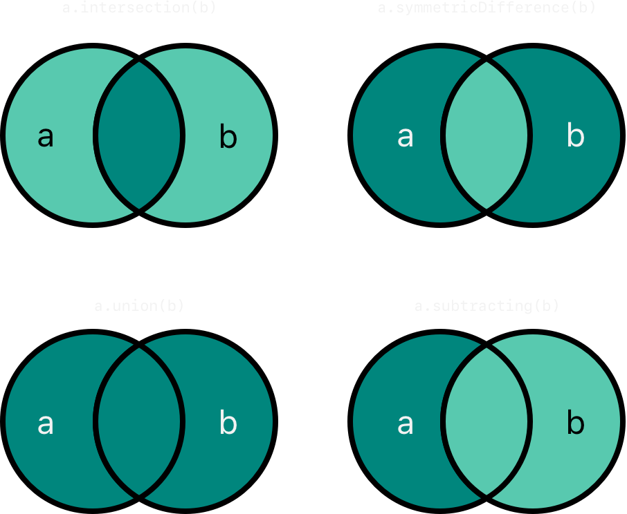
Fundamental Set Operations

Slide 31
Fundamental Set Operations
Use the intersection(_:) method to create a new set with only the values common to both sets.
Use the symmetricDifference(_:) method to create a new set with values in either set, but not both.
Use the union(_:) method to create a new set with all of the values in both sets.
Use the subtracting(_:) method to create a new set with values not in the specified set.

Slide 32
Fundamental Set Operations
let oddDigits: Set = [1, 3, 5, 7, 9]
let evenDigits: Set = [0, 2, 4, 6, 8]
let singleDigitPrimeNumbers: Set = [2, 3, 5, 7]
oddDigits.union(evenDigits).sorted()
// [0, 1, 2, 3, 4, 5, 6, 7, 8, 9]
oddDigits.intersection(evenDigits).sorted()
// []
oddDigits.subtracting(singleDigitPrimeNumbers).sorted()
// [1, 9]
oddDigits.symmetricDifference(singleDigitPrimeNumbers).sorted()
// [1, 2, 9]

Slide 33
TUPLES
A tuple is a group of different values and each value inside a tuple can be of different data types.
Here's a simple Swift tuple example:
let productDetails = ("iPhone", 1099.99, true)
Tuple groups different data types together in a comma separated list.

Slide 34
Tuple Syntax
create a tuple by writing a comma separated list of values inside parentheses. Each value within the tuple can be of any data type, and you can access tuple elements by their index:
var person = ("John", 30)
print("Name: \(person.0)") // Accessing the first element
print("Age: \(person.1)”)

Slide 35
Tuple Syntax
You can also give names to tuple elements when you define the tuple, making your code clearer:
var car = (make: "Toyota", model: "Corolla", year: 2021)
print("Car make: \(car.make)")
print("Car model: \(car.model)")

Slide 36
Accessing Tuple Elements by Index
Each element in a tuple can be accessed using an index number, starting with zero.
let userInfo = ("Alice", 25)
let name = userInfo.0 // Access the first element
let age = userInfo.1 // Access the second element
print("Name: \(name), Age: \(age)")

Slide 37
Accessing Tuple Elements by Name
Naming the elements in a tuple is optional, but it is a best practice when the tuple has more than two elements or when the context of each value isn't obvious.
let product = (id: 101, name: "Coffee", price: 2.99)
let productName = product.name
let productPrice = product.price
print("Product: \(productName), Price: $\(productPrice)")

Slide 38
Nested tuple
Naming the elements in a tuple is optional, but it is a best practice when the tuple has more than two elements or when the context of each value isn't obvious.
Tuples created as an element of another tuple are referred to as Nested Tuples.
An example is shown below:
var alphaNum = ("x", 1, 2, ("y", 3, “z"))
In the example above, we have a tuple ("y", 3, "z") as the third element of the created alphaNum tuple.

Slide 39

Unit 2—Lesson 5
Lab: Collections
Open and complete the exercises in Lab - Collections.playground

Slide 40
Notes:
L569805A-en_WW App Development with Swift © 2021 Apple Inc. This work is licensed by Apple Inc. under the Creative Commons Attribution-NonCommercial-ShareAlike 4.0 International license (https://creativecommons.org/licenses/by-nc-sa/4.0/legalcode).

